Slide 1
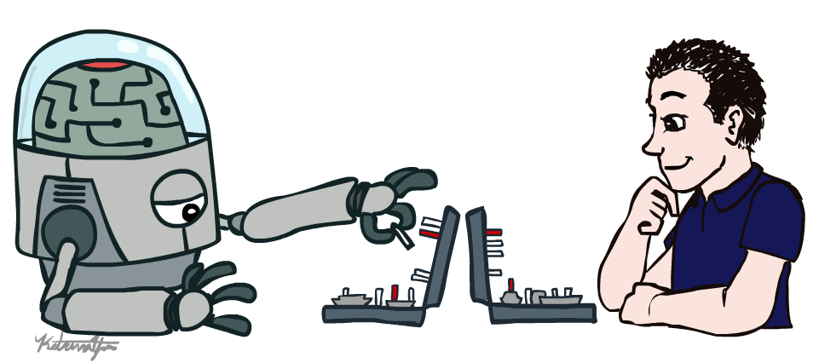
AI4007: Applied Artificial Intelligence
Introduction

Slide 2
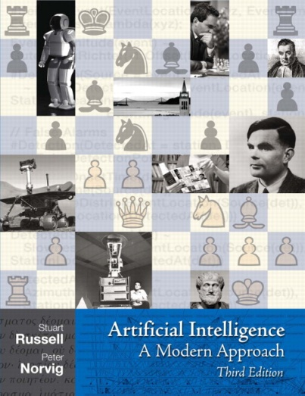
Textbook
Not required, but for students who want to read more we recommend
Russell & Norvig, AI: A Modern Approach, 3rd Ed.
Warning: Not a course textbook, so our presentation does not necessarily follow the presentation in the book.

Slide 3
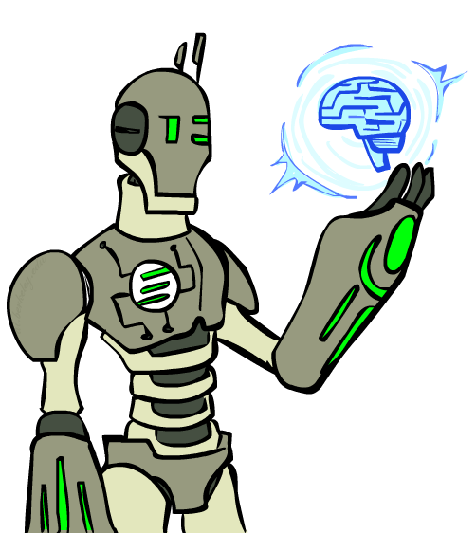
Today
What is artificial intelligence?
What can AI do?
What is this course?

Slide 4
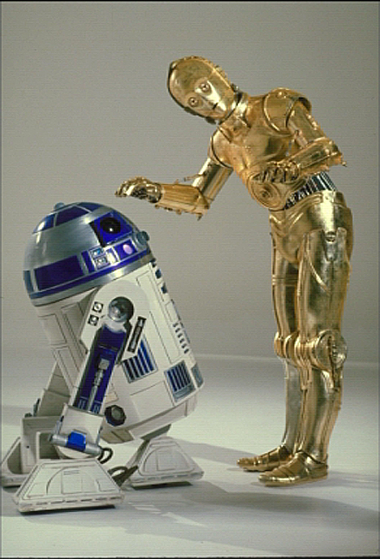
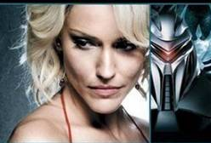
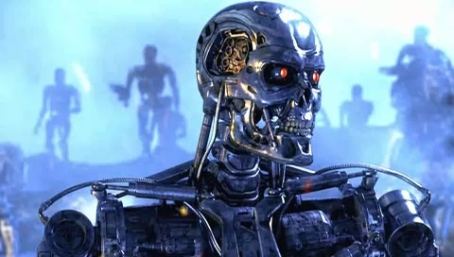
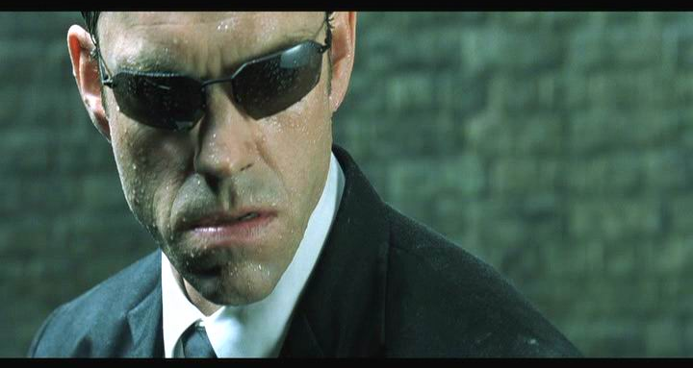
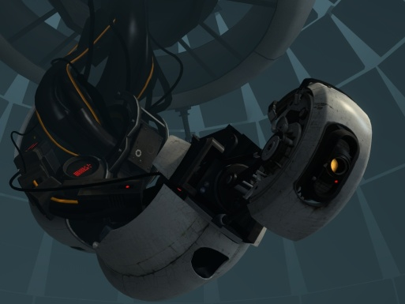
Sci-Fi AI?

Slide 5
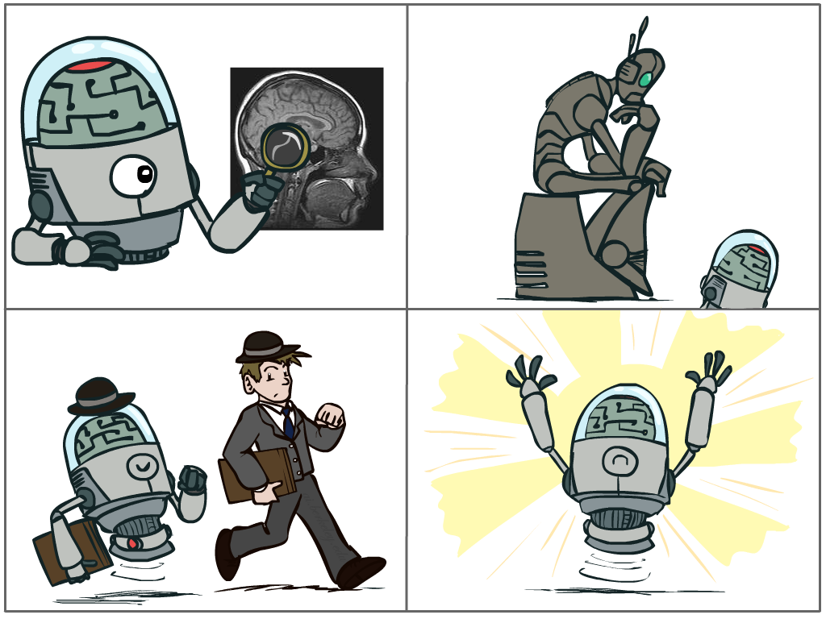
What is AI?
The science of making machines that:
Think like people
Think rationally
Act like people
Act rationally

Slide 6
Rational Decisions
We’ll use the term rational in a very specific, technical way:
Rational: maximally achieving pre-defined goals
Rationality only concerns what decisions are made
(not the thought process behind them)
Goals are expressed in terms of the utility of outcomes
Being rational means maximizing your expected utility
A better title for this course would be:
Computational Rationality

Slide 7
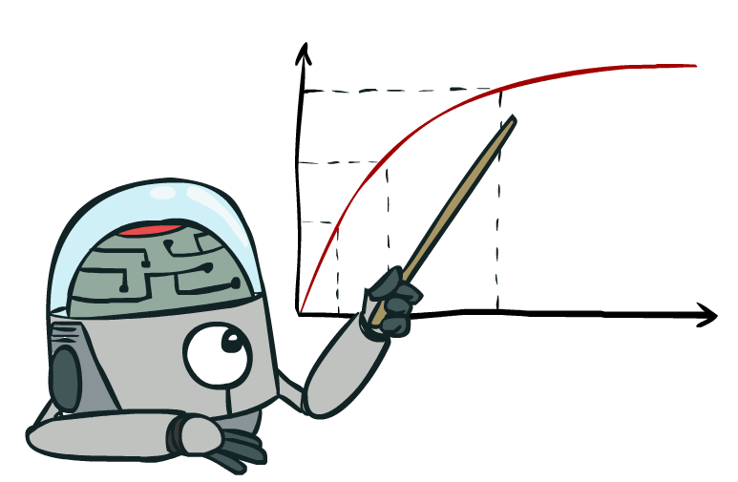
Maximize Your
Expected Utility

Slide 8
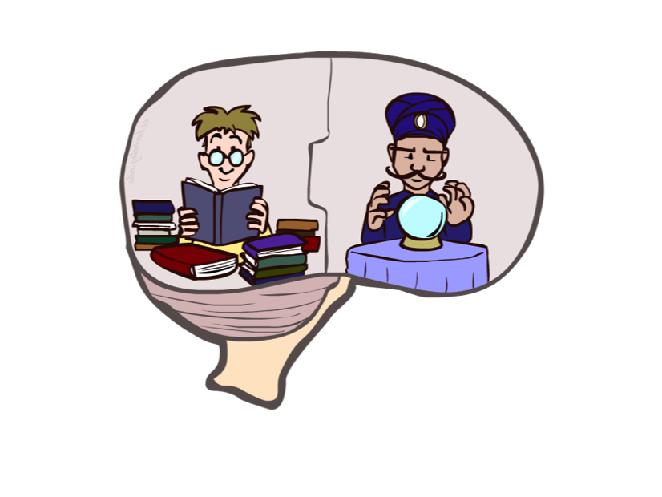
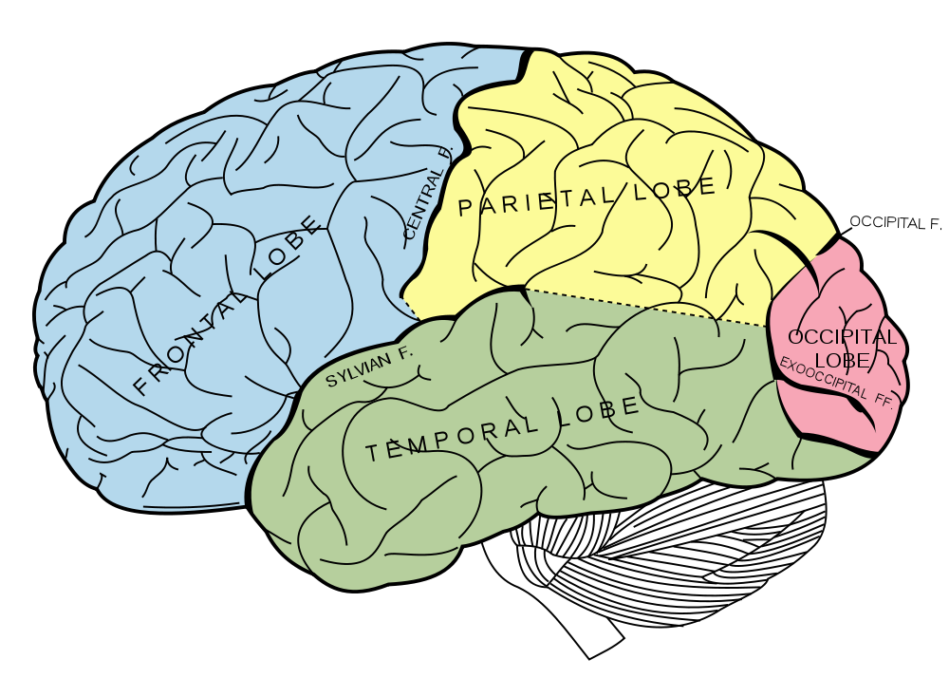
What About the Brain?
Brains (human minds) are very good at making rational decisions, but not perfect
Brains aren’t as modular as software, so hard to reverse engineer!
“Brains are to intelligence as wings are to flight”
Lessons learned from the brain: memory and simulation are key to decision making

Slide 9
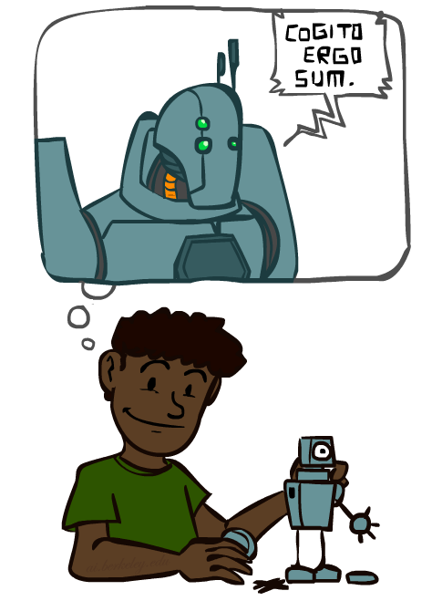
A (Short) History of AI

Slide 10
A (Short) History of AI
1940-1950: Early days
1943: McCulloch & Pitts: Boolean circuit model of brain
1950: Turing's “Computing Machinery and Intelligence”
1950—70: Excitement: Look, Ma, no hands!
1950s: Early AI programs, including Samuel's checkers program, Newell & Simon's Logic Theorist, Gelernter's Geometry Engine
1956: Dartmouth meeting: “Artificial Intelligence” adopted
1965: Robinson's complete algorithm for logical reasoning
1970—90: Knowledge-based approaches
1969—79: Early development of knowledge-based systems
1980—88: Expert systems industry booms
1988—93: Expert systems industry busts: “AI Winter”
1990—: Statistical approaches
Resurgence of probability, focus on uncertainty
General increase in technical depth
Agents and learning systems… “AI Spring”?
2000—: Where are we now?

Slide 11
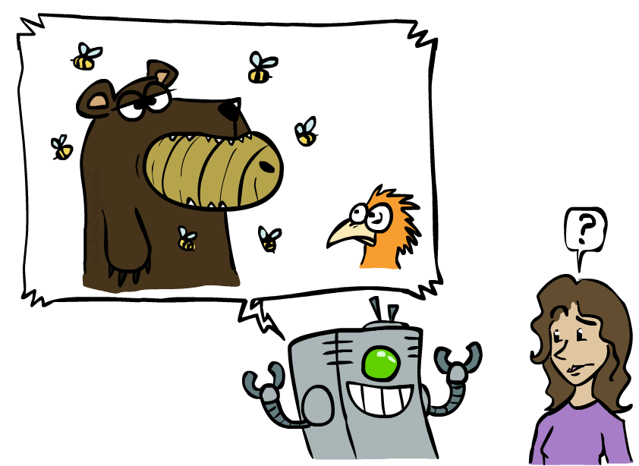
Unintentionally Funny Stories
One day Joe Bear was hungry. He asked his friend
Irving Bird where some honey was. Irving told him
there was a beehive in the oak tree. Joe walked to
the oak tree. He ate the beehive. The End.
Henry Squirrel was thirsty. He walked over to the
river bank where his good friend Bill Bird was sitting.
Henry slipped and fell in the river. Gravity drowned.
The End.
Once upon a time there was a dishonest fox and a vain crow. One day the crow was sitting in his tree, holding a piece of cheese in his mouth. He noticed that he was holding the piece of cheese. He became hungry, and swallowed the cheese. The fox walked over to the crow. The End.
[Shank, Tale-Spin System, 1984]

Slide 12
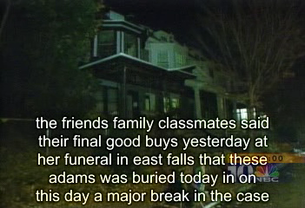
Natural Language
Speech technologies (e.g. Siri)
Automatic speech recognition (ASR)
Text-to-speech synthesis (TTS)
Dialog systems

Slide 13
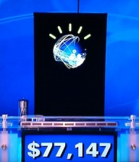
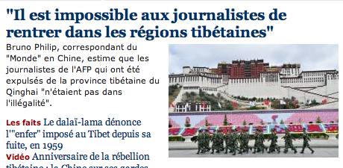
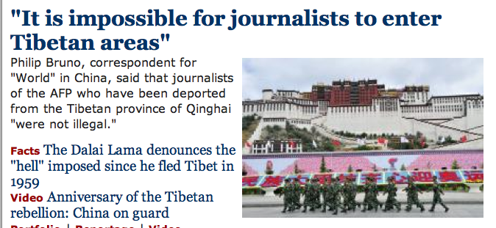
Natural Language
Speech technologies (e.g. Siri)
Automatic speech recognition (ASR)
Text-to-speech synthesis (TTS)
Dialog systems
Language processing technologies
Question answering
Machine translation
Web search
Text classification, spam filtering, etc…
Watson

Slide 14
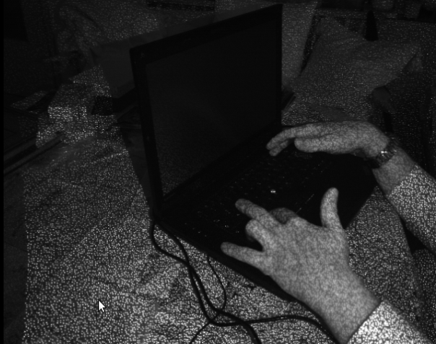

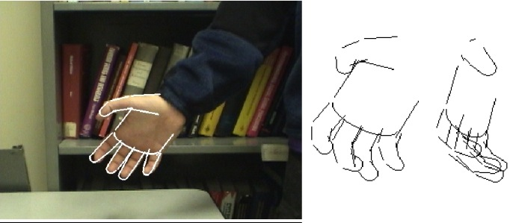
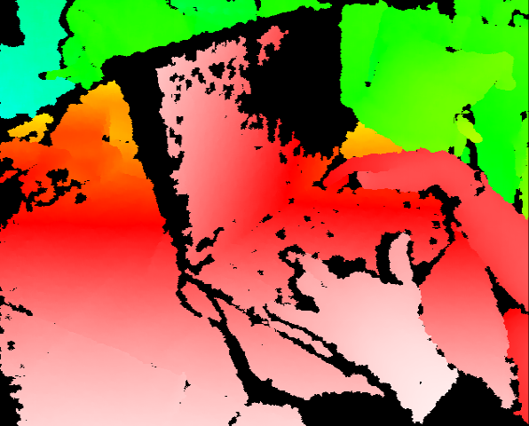
Vision (Perception)
Object and face recognition
Scene segmentation
Image classification
Images from Erik Sudderth (left), wikipedia (right)

Slide 15
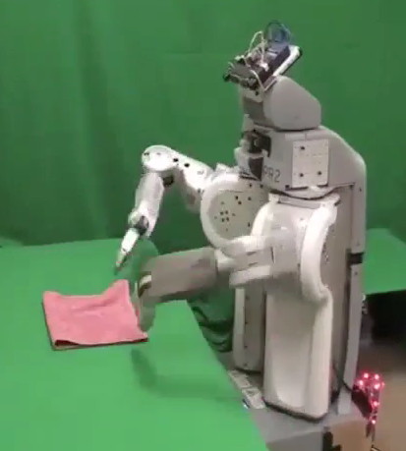
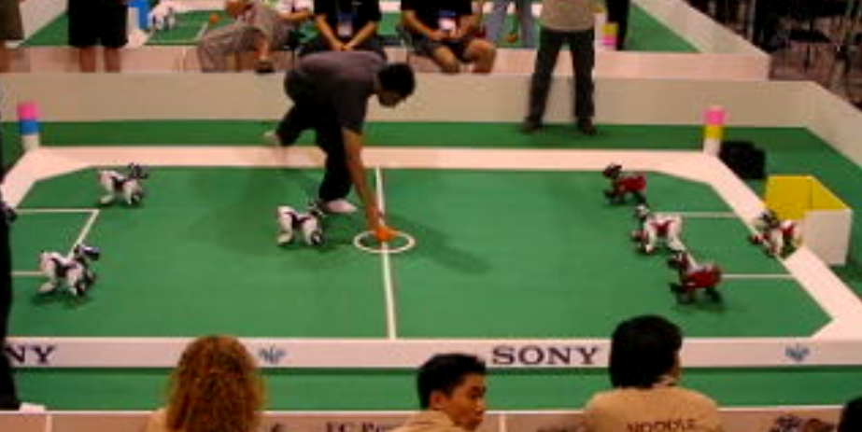
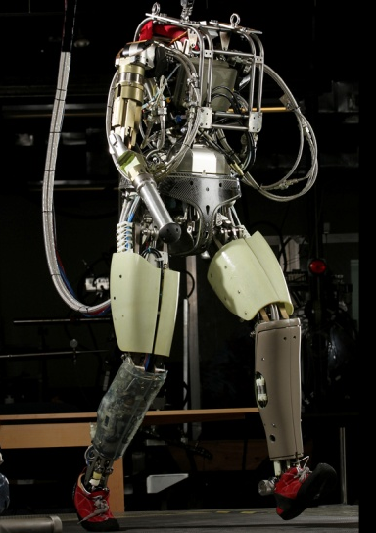
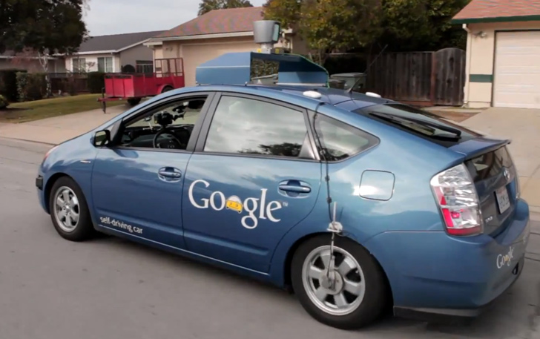
Robotics
Robotics
Part mech. eng.
Part AI
Reality much
harder than
simulations!
Technologies
Vehicles
Games!
Lots of automation…
In this class:
We ignore mechanical aspects
Methods for planning
Methods for control
Images from UC Berkeley, Boston Dynamics, RoboCup, Google

Slide 16
Logic
Logical systems
Theorem provers
NASA fault diagnosis
Question answering
Methods:
Deduction systems
Constraint satisfaction
Satisfiability solvers (huge advances!)
Image from Bart Selman

Slide 17
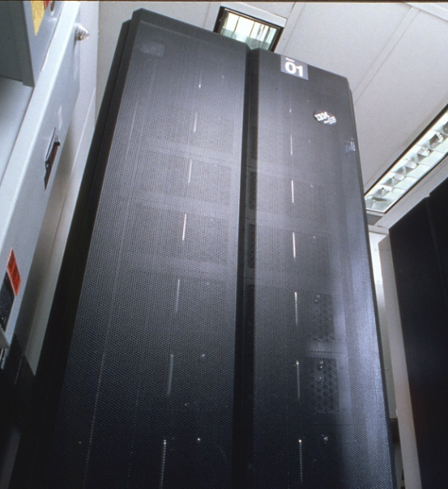
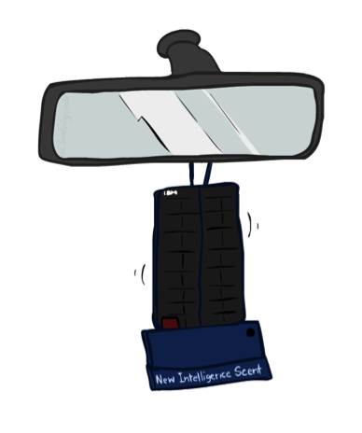
Game Playing
Classic Moment: May, '97: Deep Blue vs. Kasparov
First match won against world champion
“Intelligent creative” play
200 million board positions per second
Humans understood 99.9 of Deep Blue's moves
Can do about the same now with a PC cluster
Open question:
How does human cognition deal with the
search space explosion of chess?
Or: how can humans compete with computers at all??
1996: Kasparov Beats Deep Blue
“I could feel --- I could smell --- a new kind of intelligence across the table.”
1997: Deep Blue Beats Kasparov
“Deep Blue hasn't proven anything.”
Huge game-playing advances, e.g. in Go!
Text from Bart Selman, image from IBM’s Deep Blue pages

Slide 18

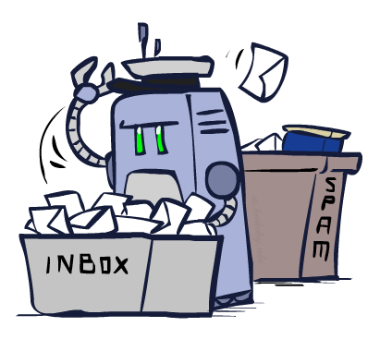
Decision Making
Applied AI involves many kinds of automation
Scheduling, e.g. airline routing, military
Route planning, e.g. Google maps
Medical diagnosis
Web search engines
Spam classifiers
Automated help desks
Fraud detection
Product recommendations
… Lots more!

Slide 19
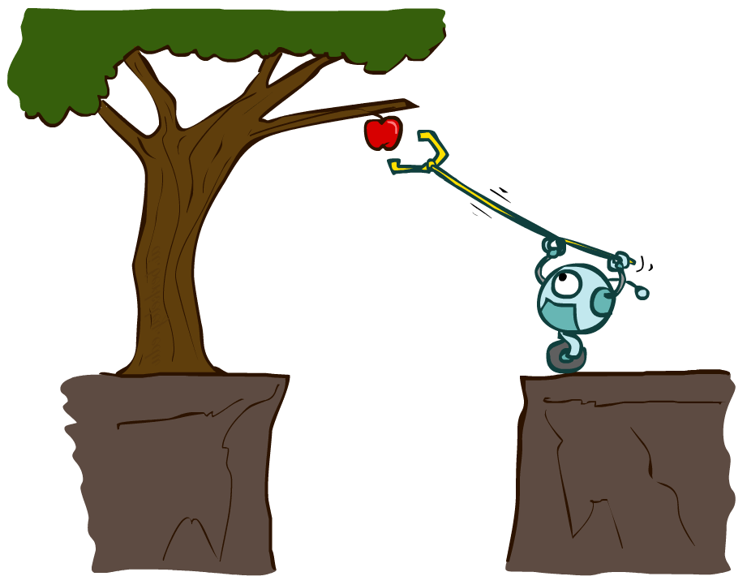
Designing Rational Agents
An agent is an entity that perceives and acts.
A rational agent selects actions that maximize its (expected) utility.
Characteristics of the percepts, environment, and action space dictate techniques for selecting rational actions
This course is about:
General AI techniques for a variety of problem types
Learning to recognize when and how a new problem can be solved with an existing technique
Sensors
Agent
Percepts
Environment
?
Actuators
Actions

Slide 20
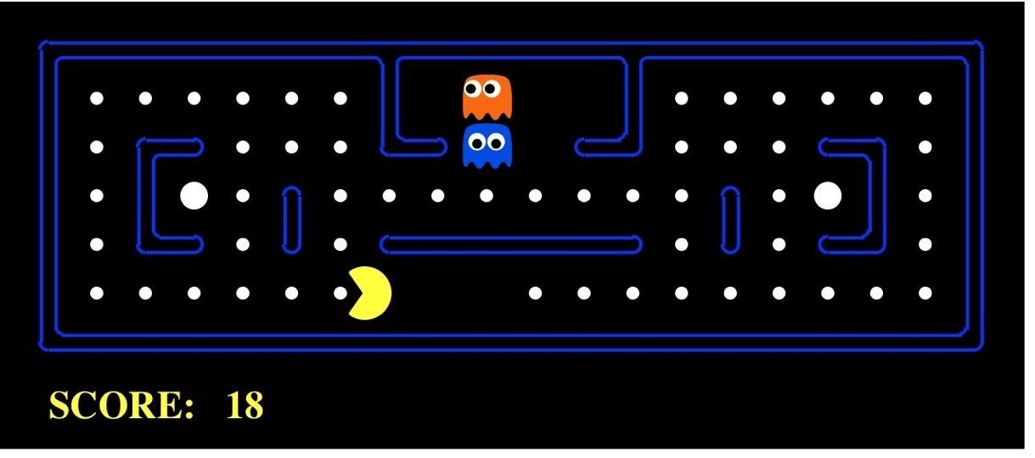
Pac-Man as an Agent
Agent
Environment
Sensors
Percepts
?
Actuators
Actions
Pac-Man is a registered trademark of Namco-Bandai Games, used here for educational purposes

Slide 21
Course Topics
Part I: Making Decisions
Fast search / planning
Constraint satisfaction
Adversarial and uncertain search
Part II: Reasoning under Uncertainty
Bayes’ nets
Decision theory
Machine learning
Throughout: Applications
Natural language, vision, robotics, games, …

